Slide 1
PID TRANSITION TRAINING
Empowering SSC

Slide 2
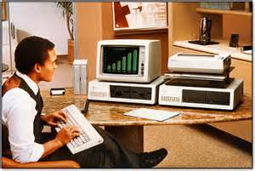
PID TRANSITION – what it means

Slide 3
AGENDA
What you do today
What you will do
When this will start
Frequently Asked Questions
Resources and Follow-up

Slide 4

How you work today
Here at SSC, currently you receive sub-arf tickets, printer requests and CTS tickets.
You work these tickets as ccs or dsrs and you either answer the customers questions and close down ticket or you schedule them for an over the phone training.

Slide 5

How you will work come Nov 1st

Slide 6
Sales Submits a Pioneer Request with hardware or without hardware
FSSC reviews sales notes Determines if it can be handled by VSSC or kept for FSSC per current guidelines ¹
If FSSC determines an integration or any other solution is required that is outside VSSC scope, FSSC will keep and work PID
FSSC will consult if needed and ensure notes reflect what needs to be accomplished by VSSC
FSSC completes the PID and notifies Sales
FSSC Transfers Original PID to VSSC designated workload
Consultation without Hardware
Consultation with Hardware
VSSC calls customer to schedule appointment for solution ²
VSSC calls customer to verify solution and/or hardware needs ³
Customer Requests Call to be Rescheduled at a new Date and Time with Vendor
Customer Indicates Call Can Not be Continued for whatever Reason and Does not want to Reschedule ⁵
Vendor is unable to reach the customer after 2 phone calls and an email
VSSC schedules appointments and coordinate hardware needs.
If hardware is needed VSSC will order per current upgrade procedures.
VSSC Reschedules
Call per current process ⁵
Vendor Terminates the PID and Notifies Sales via Nexus e-mail ⁵
If the VSSC uncovers an integration opportunity they will notify the aligned FSSC per current FSSC Action procedures ⁴. The FSSC will request new PID from sales and complete the PID ¹
VSSC Notifies Sales of the Reschedule Date and Time.
VSSC completes current training and updates notes/sales per current process.

Slide 7
SUBARFING AROUND
Under the new process, you will take a PID and will be able to create SUB-ARFs off of it if necessary or work it as per normal .
Multiple solutions
Multiple contact points
LAR Account (more on that later)

Slide 8
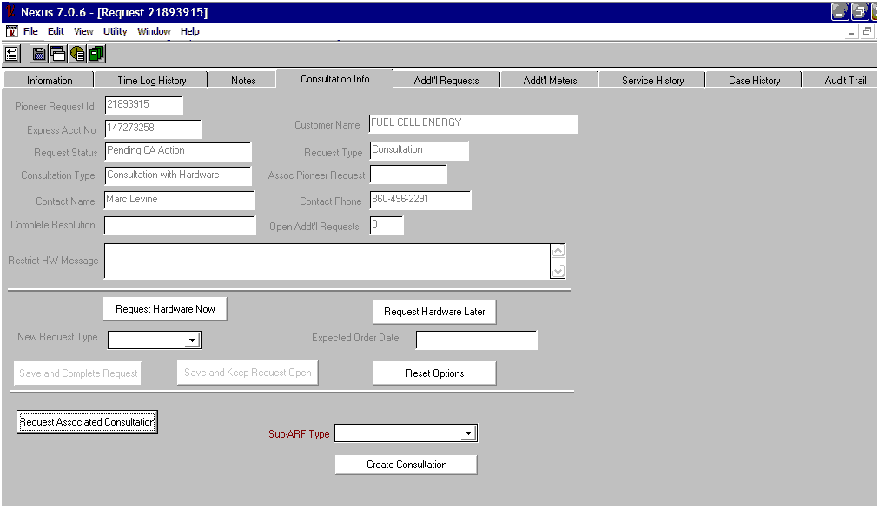

Subarfing USA
Creating Sub-Arfs

Slide 9
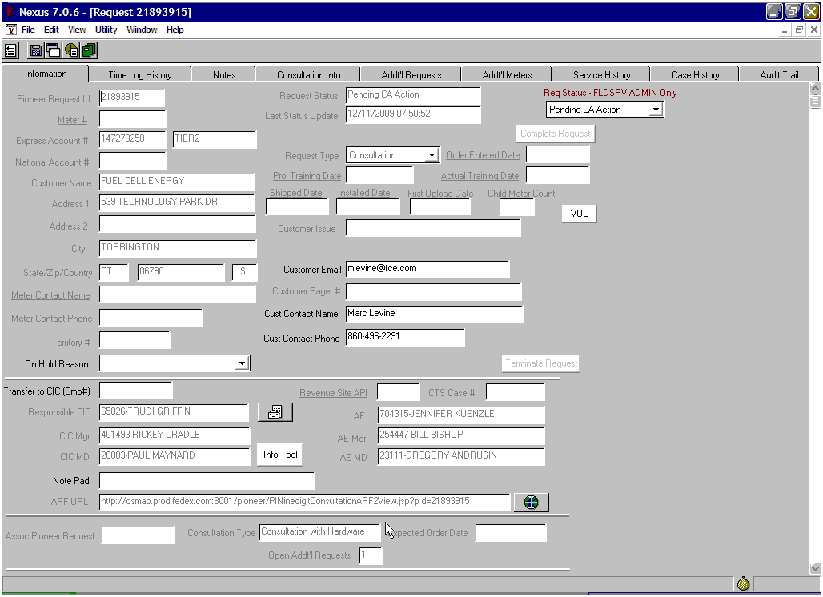
A multitude of sub-arfs

Slide 10
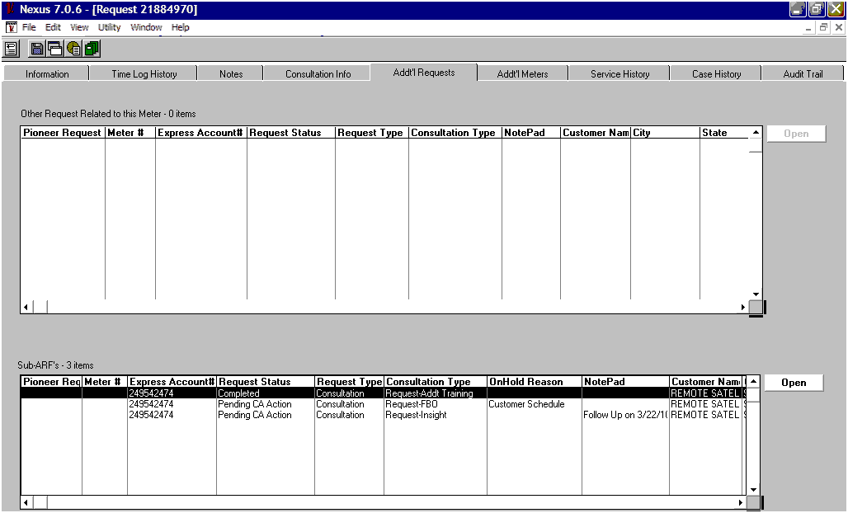
Additional Sub-Arf shenanigans

Slide 11
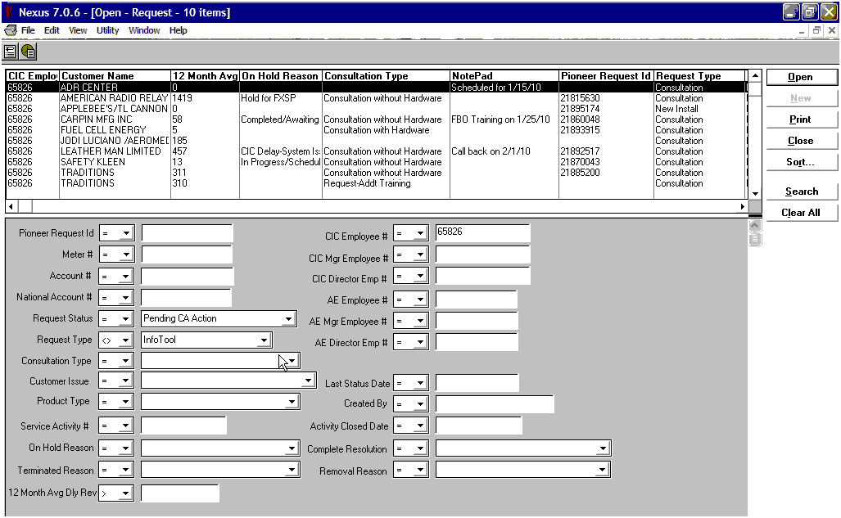
NOTEPAD NICETIES

Slide 12
To close or not to close
Complete a ticket if customer has been contacted.
Terminate a ticket if customer has not been contacted.

Slide 13

TERMINATOR I
No reply from the customer after following am/pm/email process

Slide 14

TERMINATOR II
IF THE TICKET IS A DUPLICATE

Slide 15

TERMINATOR III
IF SALES CANCELS THE REQUEST BEFORE YOU CONTACT THE CUSTOMER

Slide 16
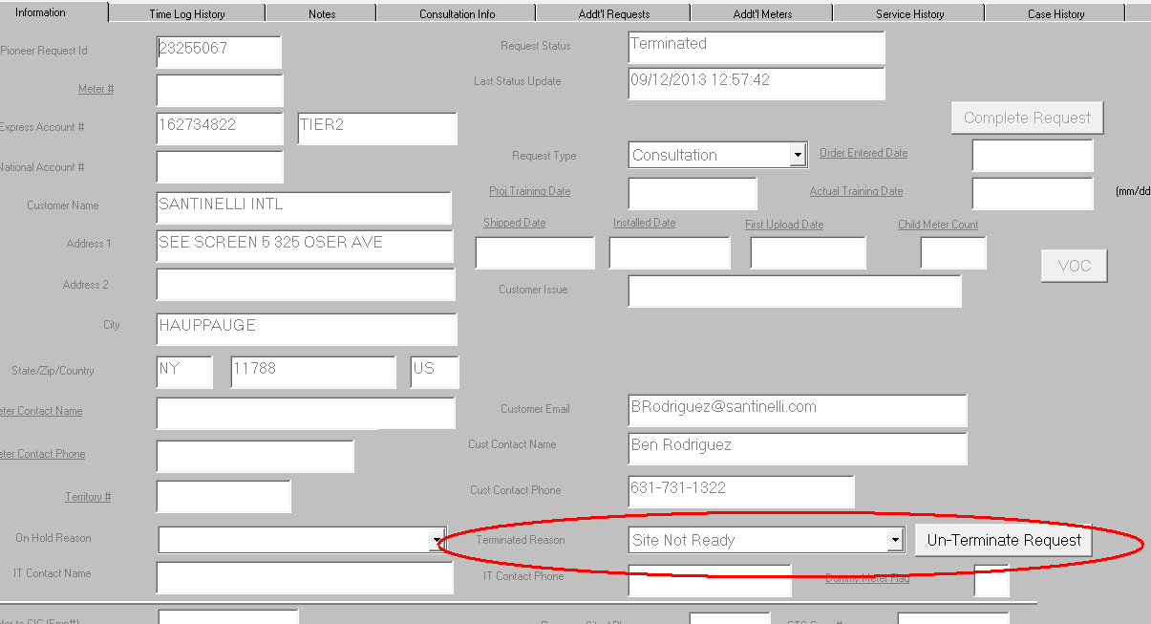
Bringing it back to life
Up to 14 days after initial TERMINATION

Slide 17
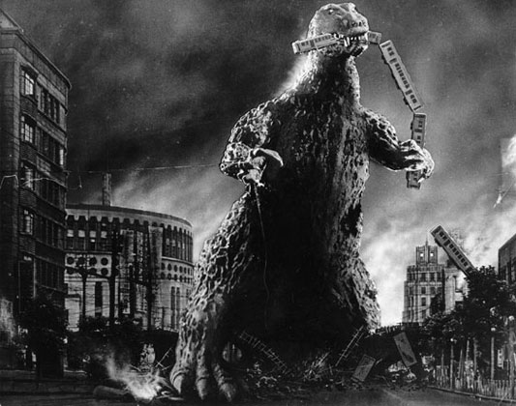
Large Account Roll-Out LAR

Slide 18
Largely Speaking
Corporate/Global Company
Tier 3 level of business
FSSC VALIDATION: to Hector Garcia ‘hegarcia@fedex.com’:
Company Name
Single Point of Customer Contact name and contact details.
Detailed description on type of training required and all requirements. i.e.: Ship Admin Training, in 4 GoToMeeting (GTM) or GoToWebinar (GTW) groups, date and time of training for each group, other specifics on training request.
Hector will coordinate the LAR trainings with the Vendor Team and ask you to submit the Original PID to Gerald Lewis’ workload (Employee Id: 782406).
PM to be copied in on all LAR comms
Before you transfer the PID to Gerald’s workload, update Notepad to indicate: ‘LAR / Hector scheduling with Gerald Lewis directly.’
After Scheduling, Hector will confirm the Single Point of VSSC Trainer’s name via email to FSSC.
The LAR requests will then be handled per normal processes by the assigned VSSC Trainer.

Slide 19
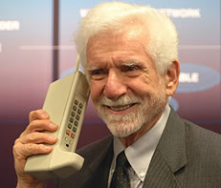
THANKS FOR PARTICIPATING

Slide 21
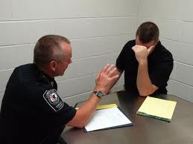
Frequently Asked Questions
Will everything else remain the same ?
Do we have to work all sub-arfs we create ourselves?
How does this affect our Cycle time?

Slide 22

Resources & Support
The Purple Page will be updated with process docs outlining the new processes.
Colin and Al will be available during the first week of the cross-over
KBs will be updated by the VMT to support the initiatives
Greg Syth and Jason P have hands on knowledge of the new processes

Slide 24
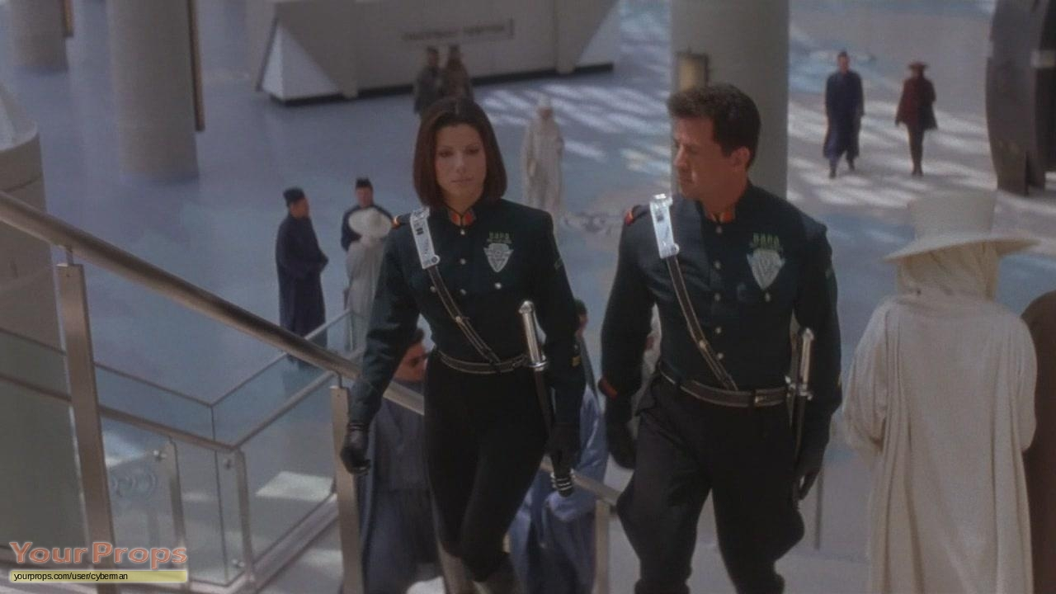
So, we can now make sub-arfs?

